Slide 1

Predictive Analysis of Satellite Telemetry
LTM

Slide 2
Table of Contents
Important Definitions
01
Implications
02
The Data
03
Question
04
Data Cleaning
05
Visualizations
06
Conclusion
07

Slide 3
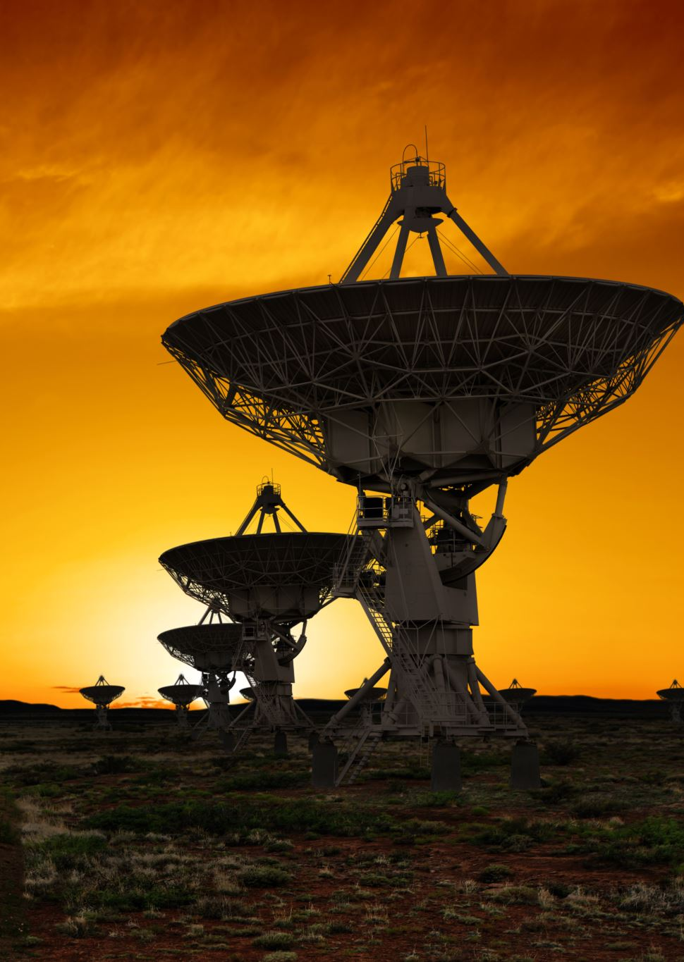
Important Definitions
Telemetry
Satellite Bus
Reaction Wheel
Notes:
1. Telemetry
- Telemetry refers to the automated collection of data from remote locations, such as satellites, and its transmission to receiving equipment for monitoring. In the context of satellites, telemetry data includes information on the satellite's location, temperature, altitude, battery status, and other critical parameters.
2. Satellite Bus
- A satellite bus, also referred to as a spacecraft bus, is a general model or platform that functions as the support infrastructure for a satellite. It provides the necessary subsystems and structure to support and interface with the payload, which is the mission-specific part of the satellite.
3. Reaction Wheel
- A reaction wheel is a type of device used in satellites to control their orientation without using thrusters or any consumable resources. It's a part of the satellite's attitude control system.
- The reaction wheel is essentially a flywheel, which is a heavy wheel that spins around a central axis. By adjusting the speed at which the wheel spins, you can change the angular momentum of the entire satellite.

Slide 4
Implications
Missing Data
Not on cover
Bad data
Encryption
Cross referencing
Notes:
By creating models that can accurately predict missing data from telemetry signals we can gain insight into what the satellite was doing when it was not on cover by a ground station. Satellite Telemetry signals are designed to not be as accurate and favors sending mass amounts of data rather than precise data so models like the one seen here can also help filter out bad data in the telemetry signal.
Additionally, satellite telemetry in recent years is more and more likely to be encrypted. By utilizing models like these we can make better informed inferences on what a satellite is doing based off of what measurements we can take of the satellite.
During the launch telemetry is usually sent in the clear where we can take measurements and characterize the signals and build predictive models. Later when the signals become encrypted we can then cross-reference the predictive models and other measurements of the satellite with the encrypted signal to aid in breaking out the telemetry.

Slide 5
The data
UCB – LASP
Measurements
Battery Temperature
Bus Voltage
Bus Current
Reaction Wheel Temperature
Reaction Wheel RPM
Notes:
The dataset that I used was gathered over ten years by the University of Colorado Boulders Laboratory for Atmospheric and Space Physics (LASP). The data came from an unnamed satellite with a telemetry beacon emitting data at regular intervals. This dataset focused specifically on 5 measurements. Battery Temperature, Bus Current, Bus Voltage, Reaction Wheel Rotations Per Minute, and Reaction Wheel Temperature.
For the purposes of this project I completed a supervised machine learning model with Reaction Wheel RPM as the target and the other data points as features to measure if the features worked as indicators that the Reaction Wheel was spinning

Slide 6
Question
Does Battery Temperature, Bus Voltage, Bus Current, and Reaction Wheel Temperature serve as an indicator of whether the Reaction Wheel is spinning

Slide 7
Data cleaning
Time bounds
Inferring missing data
RPM
All other features
Notes:
Because of the variance in range in which the data was collected I decided to only analyze the data from 2010 and onwards. The cadence in which values were collected did not prove to impact the analysis negatively and were therefore not handled.
The RPM category did contain nan values which was interpreted to mean that the wheel was not spinning and was treated as a zero.

Slide 8
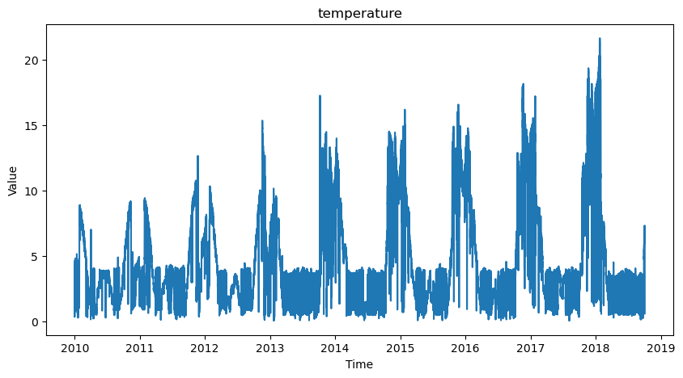
Battery temperature
Degrees Celsius

Slide 9
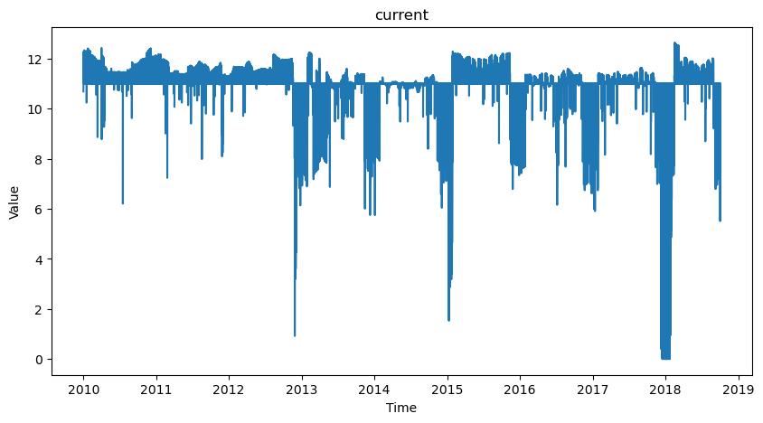
Bus Current
Amps

Slide 10
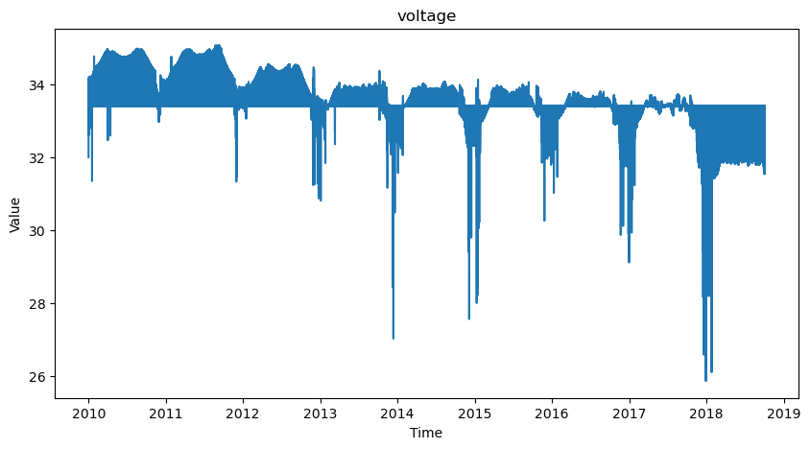
Bus voltage
Volts

Slide 11
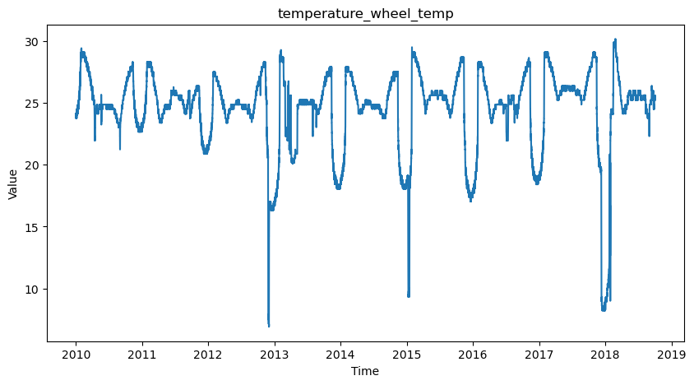
Reaction Wheel Temperature
Reaction Wheel Temperature
Degrees Celsius

Slide 12
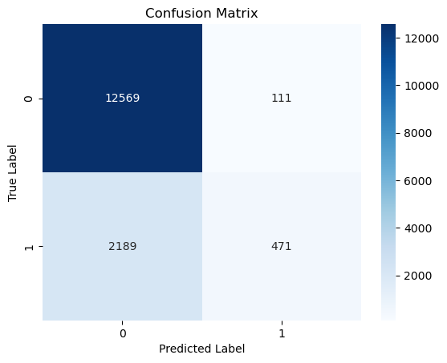
Confusion Matrix
False Positive
True Negatives
False Negatives
True Positive
Notes:
Great at predicting true negatives, could be better at predicting true positives

Slide 13

Conclusion
Weight of features
Logistic Regression Model
What this means for telemetry analysis
Notes:
VIF: The Variance Inflation Factor showed that the Reaction Wheel Temperature and Current Bus Total, 3.6 and 4.2 respectively were the greatest indicators of factors in being able to determine whether the Reaction Wheel was spinning.
T-statistic: -35.43250337052465 P-value: 8.7658500031998e-273 There is a significant difference in battery temperatures between spinning and non-spinning conditions.
The Logistic Regression model produced an accurate result 85% percent of the time.
Significance of Reaction Wheel RPM: The reaction wheel's RPM, being the focal point of this study, was successfully used as a target variable for our machine learning model. By predicting its activity, it is possible to determine vital aspects of satellite orientation control.
Features as Indicators: Battery Temperature, Bus Voltage, Bus Current, and Reaction Wheel Temperature were rigorously tested as predictors. Our initial hypothesis was evaluated against the dataset, and it was found that these telemetry features served as good indicators of whether the Reaction Wheel was in operation. Therefore, I was able to reject the null hypothesis and adopt the alternative.
Dealing with Imperfections: The data was not without its challenges. Incomplete or missing readings, potential anomalies, and differing cadences across measurements required meticulous data cleaning and preprocessing. However, this process further highlighted the importance of refining raw telemetry data to extract meaningful and actionable insights.
Implications of Visualizations: The presented visualizations serve as an excellent tool for understanding the behavior of individual telemetry parameters over time. Such graphical representations enable domain experts, engineers, and data scientists to visually detect patterns, anomalies, or any correlations between different parameters.
Value of Predictive Models in Satellite Telemetry: The successful modeling of the telemetry data underscores the value of predictive analytics in the field of satellite operations. While telemetry data might be prone to inaccuracies or encryption, predictive models like the one developed here offer a way to both improve the quality of the data interpretation and potentially infer the behavior of encrypted signals.

Slide 14
Wrap-up
London.Thomson_merriman@spaceforce.mil
Github Repository: https://github.com/sys-usr/Satellite-Telemetry/tree/master
Questions?

Slide 15
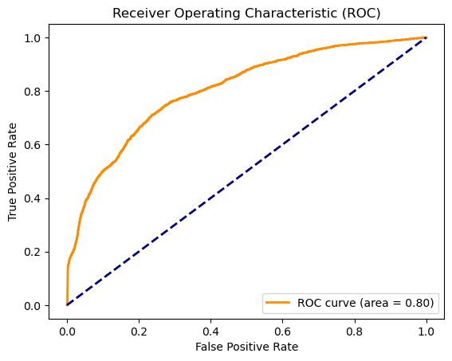
Receiver Operating Characteristic

